Slide 1
A Proposal to offer Technical Solutions to Prevent Cooking Oil Splashes Posing a Burning Risk for the Cook's Face in a Private Residence Kitchen, Ankara
Murat Ertan
22003067
ENG401 Section: 003

Slide 2
contents
Introduction
Problem Definition
Proposed Solutions
Criteria for Assessing Solutions
Research Methodology
Results and Analysis
Conclusion and Recommendations
References

Slide 3

A) Introduction
Security Problem
Oil splashes [1] are among the most common kitchen health risks
Most thermal burns [2] happen in the kitchen
Oil splashes [2] risk [3] category two thermal burns

Slide 4
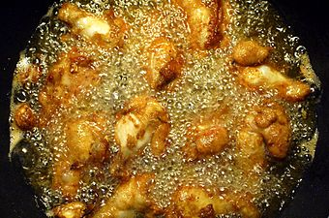
A) Introduction
Oil Splashing
Fig. 1: Deep Frying [4]
Notes:
Testting

Slide 5

A) Introduction
A Burned Face
Fig. 2: Burned Face [5]

Slide 6

A) Introduction
Pilot Study Area (PSA)
In the PSA, the cook fries weekly in direct contact with the oil [7] where is a private kitchen in Ankara
The cook experienced a burning risk before
Oil splashes pose burning risk [3] to the cook
PSA’s cook fries twice a week
Fig. 3: Cooking with oil [6]

Slide 7
A) Introduction
The Proposal’s
Purpose
offer engineering solutions to decrease facial burning risk when cooking with oil in the PSA
Impact
offer confidence for the cook in the PSA against facial burning risks regarding reliability, cost and usability
Significance
provide an example for other kitchens and restaurants

Slide 8
B) Problem definition
The PSA
The PSA is a cook’s kitchen in a private residence, Ankara
The cook fries food on the kitchen’s stove top
Stove top, borders the kitchen’s walls
There is 30 cm between the PSA’s wall and stove top which is used for frying

Slide 9

B) Problem definition
Problem’s Physics
In oils' high boiling temperatures, water cannot be in liquid phase [6]
When water gets into the pan in the PSA, and encounters [9] the cooking pan’s bottom
The pan’s bottom quickly boils the water, which moves under the oil (water is denser [10] than cooking oils)
Fig. 4: Oil Splash [8]

Slide 10
B) Problem definition
Problem’s Physics
Quick evaporation makes water expand [9] and turn to gas, moving oil molecules upward
Oil splashes, creating high-temperature projectiles in the PSA
The oil splashes can go in any direction, posing a burning risk [7]
Fig. 4: Oil Splash

Slide 11
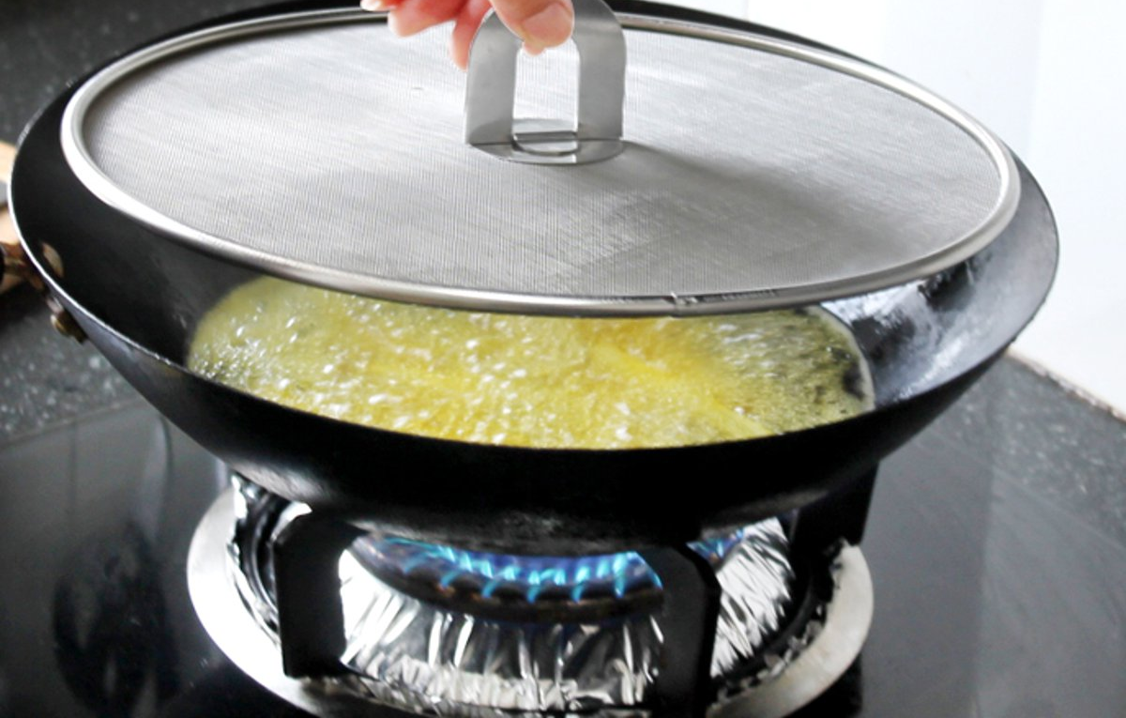
B) Problem definition
The Symptom
So, in the PSA, High-temperature projectiles [1] can harm the cook’s face and the surrounding people if any were present
Fig. 5: Oil splashes being covered [11]

Slide 12
B) Problem definition
Problem Bottlenecks
PSA’s Oil Splashes
Due to water in the cooking oil (while cooking)
Bursting upward
Hitting the cook’s face
Having a high temperature

Slide 13
B) Problem defınıtıon
The Problem Scope
Who: Cook in PSA
Where: Kitchen in PSA
What: Cooking oil splashes pose a burning risk to the cook’s face
How: Oil splashes generate most [2] of the thermal burning [3] cases in kitchens
Why: Frying food at high temperatures with oil causes the water in the food to expand and make oil splash
When: While cooking with hot oil in direct contact

Slide 14
C) Proposed Solutions
Proposed Solutions
Three technical solutions named
Protective Transparent U-Shaped Case (PTC)
Redirecting the Oil Splashes with Air (ROSA)
Using Liquid Glucose to Absorb Water in the Oil (ALGO)
are proposed to address oil splashes posing a burning risk to the cook’s face in the PSA

Slide 15
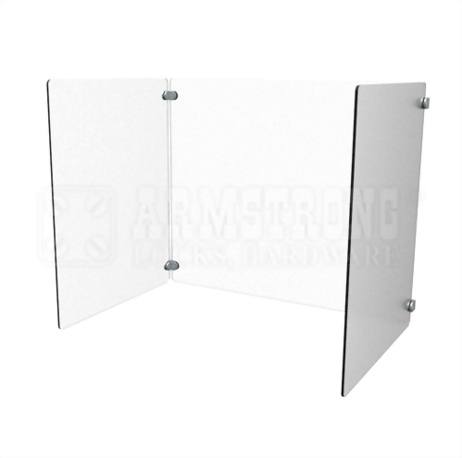
C) Proposed Solutıons
PTC
The U-shaped case will cover the pan
Case is made from fire and heat-durable polycarbonate [12] sheeting
Polycarbonate sheets are transparent
Fig. 6: Protective Case [13]

Slide 16
C) Proposed Solutıons
PTC
The cook’s stove top is 0.3 x 0.5 m. Considering the pan’s diameter of 0.3 meters, PTC must have a size of 0.3 x 0.3 width and length
In total, 0.3 m2 polycarbonate is needed to construct PTC [12]
For assembling the sheets, a mechanical engineer will be hired
Fig. 6: Protective Case

Slide 17
C) Proposed Solutions
PTC
Polycarbonate sheets are transparent
The case will be in a U shape with a size of 0.3 x 0.3 width and length
The cook can interreact with the food from the front of the stove top
Sheets will be connected by the hired mechanical engineer
Fig. 6: Protective Case

Slide 18
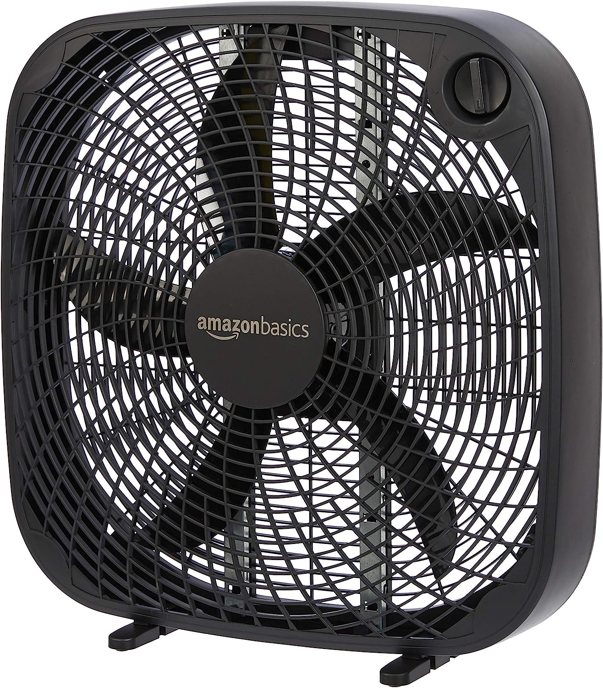
C) Proposed Solutıons
ROSA
This solution aims to redirect oil splashes while cooling the hot oil splashes down by convection [14] and airflow [15] [16]
The socket in the stove top wall will be used for powering the 0.055 kw fan [17]
The fan, according to the cook’s preference, can be placed within the 30 cm between the wall and stove top
Fig. 7: Air fan [17]

Slide 19
C) Proposed Solutions
ROSA
An electric-powered plastic fan will be moved against the wall covering the heating zone by the cook when frying food
The fan will be placed on the counter, which is parallel to the stovetop
The fan is 14.224 D cm x 52.324 W cm x 54.102 H cm [17]
The fan will blow air perpendicular to the stovetop without any level difference from the stovetop
Fig. 7: Air fan

Slide 20
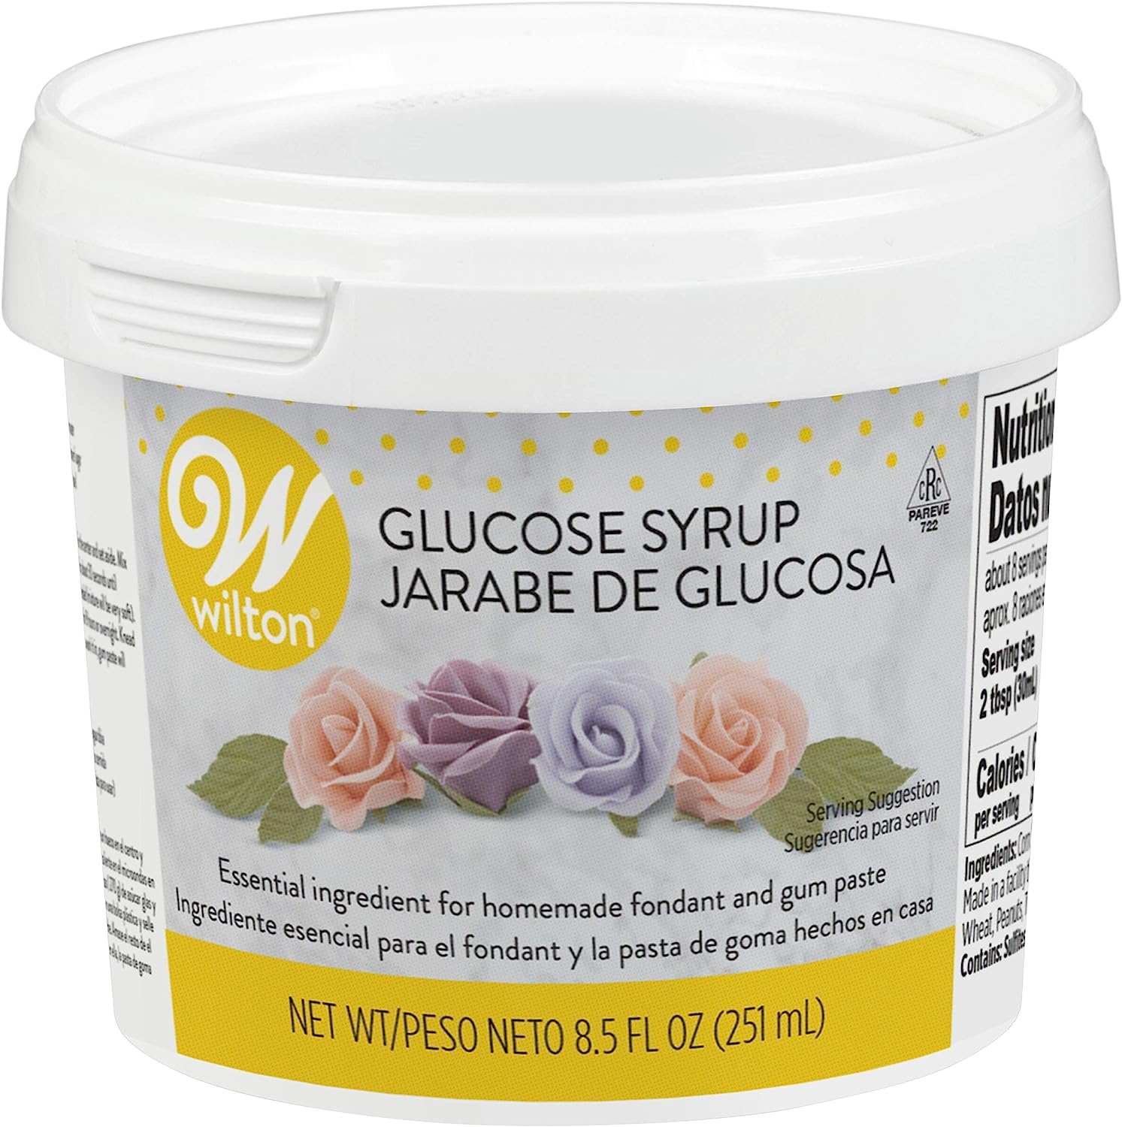
C) Proposed Solutıons
ALGO
Adding glucose solution to oil will prevent oil splashes
The glucose powder has been used for frying [18]
Adding glucose solution would create a layer under the oil and on the pan’s surface
Fig. 8: Glucose Syrup [19]

Slide 21
C) Proposed Solutıons
ALGO
The cook will mix glucose solution with preferred frying oil at 1:1 volume [20]
The cook, if necessary, can add more glucose to the frying process
For an average case, 100 ml oil with 100 ml glucose will be used
Fig. 8: Glucose Syrup

Slide 22
D) Criterıa for assessing solutions
Criteria
All the solutions have been checked according to their
Reliability (40%) [21]
Usability (35%) [22], [23]
Cost (25%) [24]

Slide 23
D) Criterıa for assessing solutions
Reliability (40%)
All solutions have been checked according to the degree of
Preventing oil splashes from reaching the cook’s face [18], [12], [13]
Their successful and reliable functioning rate for 30 minutes [25], [6], [11]

Slide 24
D) Criterıa for assessing solutions
Usability (35%)
All solutions have been checked according to the degree of
blocking the cook’s interaction space [6], [25], [23]
affecting the frying process [20]

Slide 25
D) Criteria for assessing solutions
Cost (25%)
Assuming each solution will be used for a year, annual costs have been checked for each solution
Purchasing, installing and maintaining cost (PTC, ROSA) [12], [17], [30], [31]
Purchasing cost (ALGO) [19]

Slide 26
E) Research methodology
Methods
Field observation [26]
Literature review [27]
Market research [28]
Have been proposed to assess each solution’s criteria

Slide 27
E) Research methodology
Field Observation
Field observation in PSA has been conducted to check
Reliability
Usability
of all solutions [7]

Slide 28
E) Research methodology
Literature Review
A literature review has been conducted to assess the usability and reliability of all solutions
PTC [29]
ROSA [29]
ALGO [20], [25]

Slide 29
E) Research methodology
Market Research
Market research has been conducted to determine the total annual cost for each solution
PTC [12], [30]
ALGO [19]
ROSA [17], [30], [31]

Slide 30
f) Results and analysis
Scoring
Four states will assess the reliability (40%) and usability (%35).
These are from lowest to highest:
unsatisfactory (0)
hardly satisfactory (1)
moderately satisfactory (2)
completely satisfactory (3)
For assessing cost, the complementing weighted average to 100% have been used, over the total cost for each solution without accounting monthly inflation

Slide 31
f) Results and analysis
Reliability (40%) Checklist
Checklist | Points [0-4] | Reason
The solution prevents horizontal oil splashes
The solution prevents vertical oil splashes
The solution prevents damaging hot oil splashes
The solution doesn’t need re-adjustments during cooking
The solution works for 30 minutes without dysfunctioning
The solution is neither damaged by oil splashes nor heat

Slide 32
f) Results and analysis
Usability (35%) Checklist
Checklist | Points [0-4] | Reason
The solution does not interfere with other equipment
The solution can be stored with space efficiency
The solution is easy to learn and memorise usage
The solution is easy to setup
The solution can be cleaned easily
The solution does not affect the fried food’s taste
The solution doesn’t lead to frequent and severe user errors
The solution enables easy recovery from user errors

Slide 33
f) Results and analysis
PTC’s Reliability
Checklist | Points [0-4] | Reason
The solution prevents horizontal oil splashes | 2 | The frontal side is open for cooking process
The solution prevents vertical oil splashes | 4 | Upward direction is covered dully
The solution prevents hot oil splashes | 1 | Doesn’t cool oil splashes
The solution doesn’t need re-adjustments during cooking | 4 | It is used stationary
The solution works for 30 minutes without dysfunctioning | 4 | Solution has no time-dependent parts
The solution is neither damaged by oil splashes nor heat | 2 | Oil tends to accumulate on the surface
17/24

Slide 34
f) Results and analysis
ROSA’s Reliability
Checklist | Points [0-4] | Reason
The solution prevents horizontal oil splashes | 4 | Airflow blows away the oil splashes
The solution prevents vertical oil splashes | 4 | Airflow blows away the oil splashes
The solution prevents hot oil splashes | 3 | Airflow cools the oil splashes [16]
The solution doesn’t need re-adjustments during cooking | 4 | Works unless the electricity is gone
The solution works for 30 minutes without dysfunctioning | 4 | Solution isn’t affected by time
The solution is neither damaged by oil splashes nor heat | 2 | Oil can splash to the fan
21/24

Slide 35
f) Results and analysis
ALGO’s Reliability
Checklist | Points [0-4] | Reason
The solution prevents horizontal oil splashes | 3 | Oil splashes but with reduced range [20]
The solution prevents vertical oil splashes | 3 | Oil splashes but with reduced range [20]
The solution prevents hot oil splashes | 0 | Oil splashes felt hotter
The solution doesn’t need re-adjustments during cooking | 1 | Liquid glucose is deformed by heat [20]
The solution works for 30 minutes without dysfunctioning | 2 | Constant supplying of glucose is required
The solution is neither damaged by oil splashes nor heat | 4 | Glucose is used once per frying
13/24

Slide 36
f) Results and analysis
PTC’s Usability
Checklist | Points [0-4] | Reason
The solution does not interfere with other equipment | 2 | Leftward and rightward sides block user movement
The solution can be stored with space efficiency | 1 | The solution takes some space
The solution is easy to learn and memorise usage | 4 | User doesn’t need to learn
The solution is easy to setup | 3 | User only puts it on the stove [29]
The solution can be cleaned easily | 2 | User needs to wash all the oil
The solution does not affect the fried food’s taste | 4 | No interaction between PTC and the pan
The solution doesn’t lead to frequent and severe user errors | 3 | User can hit to the PTC during cooking
The solution enables easy recovery from user errors | 3 | If PTC is hit, some damage may occur
20/32

Slide 37
f) Results and analysis
ROSA’s Usability
Checklist | Points [0-4] | Reason
The solution does not interfere with other equipment | 2 | Air blows away all the material
The solution can be stored with space efficiency | 3 | The fan is relatively big [29]
The solution is easy to learn and memorise usage | 2 | The fan has speed settings which require some on the go learning
The solution is easy to setup | 3 | An electric socket is used with fan’s angular placement
The solution can be cleaned easily | 2 | Oil is hard to clean from the fan
The solution does not affect the fried food’s taste | 3 | Air blow cools the frying food’s surface
The solution doesn’t lead to frequent and severe user errors | 4 | Fan doesn’t interfere with the cook
The solution enables easy recovery from user errors | 3 | Unless the fan is hit, no error could occur
22/32

Slide 38
f) Results and analysis
ALGO’s Usability
Checklist | Points [0-4] | Reason
The solution does not interfere with other equipment | 4 | Glucose is only used in the pan
The solution can be stored with space efficiency | 4 | Glucose has a small container
The solution is easy to learn and memorise usage | 1 | Needs proportioning for the food type and weight
The solution is easy to setup | 3 | Cook just adds 100 ml of glucose
The solution can be cleaned easily | 4 | Glucose has a one time usage for a cooking session
The solution does not affect the fried food’s taste | 0 | Glucose sweetens the fried food [25]
The solution doesn’t lead to frequent and severe user errors | 1 | With the right proportioning, glucose neither prevents oil splashes nor keeps the cooking process unaffected
The solution enables easy recovery from user errors | 2 | Although the cook can add more glucose in case he had insufficiently added, this is prone to error
19/32

Slide 39

f) Results and analysis
PTC’s Annual Cost
Polycarbonate sheets : $51.06
$170.20 / $m^{2}$
0.3 $m^{2}$ is needed
Assembling: $91.62
Mechanical engineer’s hourly cost: $45.82
Max 2 hours assembling
Total: $142.68

Slide 40
f) Results and analysis
ROSA’s Annual Cost
Purchasing the fan: $40.47
Annual electricity cost for the fan: $6.22
Hours working annually: 52
TRY/KWH = 0,7102
USD/TRY (05/05/2023) = 19.5098
Fan’s kw = 0.055
Total: $46.69

Slide 41
f) Results and analysis
ALGO’s Annual Cost
Note that PSA’s cook fries twice a week using 100 ml glucose per session
Annual usage of liquid glucose:
52 * 2 * 100 ml = 10 400 ml
(10 400 / 251) * $9.19 = $380.48
Total: $380.48

Slide 42

G) Conclusion and recommendations
Comparison Matrix
Solution | Reliability (40%) | Usability (35%) | Cost (25%) | Weighted Total
PTC | 71% | 63% | 75% | 69%
ROSA | 88% | 69% | 92% | 82%
ALGO | 54% | 59% | 33% | 50%

Slide 43
G) Conclusion and recommendations
ROSA
Ranks #1 with 82%
ROSA wins for every criterion
The solution prevents oil splashes with least amount of effort for the cook’s PSA
Has a continuous flow of electric fee which in the long run may not be cost effective

Slide 44
G) Conclusion and recommendations
PTC
Ranks #2 with 69%
PTC also ranks #2 for every criterion
The solution has an advantage of one time investment unlike other solutions
Most durable of all solutions

Slide 45
G) Conclusion and recommendations
ALGO
Ranks #3 with 50%
Has lowest benefit/cost margin
It is the quickest solution

Slide 46

G) Conclusion and recommendations
Action Plan
The fan will be ordered from Amazon
24 days shipping & importing period
PSA’s cook can start using ROSA as soon as it arrives

Slide 47
References
[1] "How to Prevent Oil Splatter when Deep Frying,“ Frymax. [Online]. Available: https://frymax.co.uk/frying-tips/how-to-prevent-oil-splatter-when-deep-frying/. [Accessed: Mar. 9, 2023].
[2] "How to Treat a Burn From Kitchen Oil,"Healthfully. [Online]. Available: https://healthfully.com/how-to-treat-a-burn-from-kitchen-oil-12238193.html. [Accessed: Mar. 9, 2023].
[3] "Burns,“ Medlineplus. [Online]. Available: https://medlineplus.gov/ency/article/000030.htm. [Accessed: Mar. 9, 2023].
[4] "Deep Frying," Wikipedia, March 1, 2023. [Online]. Available: https://en.wikipedia.org/wiki/Deep_frying. [Accessed March 11, 2023].
[5] "AJ Pritchard’s Girlfriend Takes Off Bandages to Share Horrific Face Burns," Movieshotnews, Mar. 3, 2021. [Online]. Available: https://movieshotnews.com/music/aj-pritchards-girlfriend-takes-off-bandages-to-share-horrific-face-burns/. [Accessed March 11, 2023].

Slide 48
References
[6] "What Pans Do Professional Chefs Use?," Kitchencuddle, Feb. 7, 2023. [Online]. Available: https://kitchencuddle.com/what-pans-do-professional-chefs-use/. [Accessed March 11, 2023].
[7] M. Ertan, private communication, Mar. 2023.
[8] "Stock Photo Cooking Oil Splash," Depositphotos. [Online]. Available: https://depositphotos.com/159656708/stock-photo-cooking-oil-splash.html. [Accessed Mar. 20, 2023].
[9] “Why Does Oil Splatter Fly?,” Eatwithus, Sep. 29, 2022. [Online]. Available: https://eatwithus.net/baking/why-does-oil-splatter-fry/. [Accessed Mar. 20, 2023].
[10] “Density of Cooking Oil,” Hypertextbook. [Online]. Available: https://hypertextbook.com/facts/2000/IngaDorfman.shtml. [Accessed Mar. 20, 2023].

Slide 49
References
[11] "1 Pcs Splatter Screen,Practical Kitchen Frying Pan Splatter Screen Stainless Steel Oil Proofing Lid," Walmart. [Online]. Available: https://www.walmart.ca/en/ip/1-Pcs-Splatter-Screen-Practical-Kitchen-Frying-Pan-Splatter-Screen-Stainless-Steel-Oil-Proofing-Lid/2ENHOJR2VSQD. [Accessed Mar. 20, 2023].
[12] “Fire Retardant Polycarbonate Sheet UF-48x96x.125in,” Acplasticsinc. [Online]. Available: https://www.acplasticsinc.com/products/0000-125-48x-96-tuffak-lf-uf. [Accessed: Mar. 9, 2023].
[13] “Protective Barier System,” Armstrong Locks. [Online]. Available: psu-c3210.jpg (499×494) (mweb.com.tw). [Accessed: Mar. 9, 2023].
[14] “Convective Heat Transfer,” The Engineering Toolbox. [Online]. Available: https://www.engineeringtoolbox.com/convective-heat-transfer-d_430.html. [Accessed: Mar. 9, 2023].
[15] “Understanding the Principles of Laminar Airflow,” Cadence. [Online]. Available: https://resources.system-analysis.cadence.com/blog/msa2022-understanding-the-principles-of-laminar-airflow [Accessed: May. 2, 2023].

Slide 50
References
[16] “What is Fluid Dynamics,” ThoughtCo. [Online]. Available: https://www.thoughtco.com/what-is-fluid-dynamics-4019111 [Accessed: May. 1, 2023].
[17] “PELONIS 3-Speed Box Fan For Full-Force Circulation With Air Conditioner, Upgrade Floor Fan, Black,” Amazon. [Online]. Available: https://www.amazon.com/PELONIS-PFB50A2ABB-V-Full-Force-Circulation-Conditioner/dp/B087C2LJ25/ref=sr_1_7?crid=BX3GPBM8C73G&keywords=fan&qid=1679155419&sprefix=vantuz%2Caps%2C1320&sr=8-7&th=1. [Accessed: Mar. 9, 2023].
[18] “Glucose powder: what it is and how to use it for fried food,” Cookist. [Online]. Available: https://www.cookist.com/glucose-powder-what-it-is-and-how-to-use-it-for-fried-food/. [Accessed: Mar. 9, 2023].
[19] “Wilton 707-2601 Glucose Syrup, 8.5 ounce, Package may vary,” Amazon. [Online]. Available: https://www.amazon.com/Wilton-707-2601-Glucose-Syrup/dp/B01EOK9GVU/ref=sr_1_1?keywords=glucose+syrup&qid=1679156138&sr=8-1. [Accessed: Mar. 9, 2023].
[20] “On the Possibility of Nonfat Frying Using Molten Glucose,” Pubmed. [Online]. Available: https://pubmed.ncbi.nlm.nih.gov/25492403/ [Accessed: May. 1, 2023].

Slide 51
References
[21] “Reliability Engineering 101 – Definition, Goals, Techniques,” Limblecmms, Oct. 8, 2020. [Online]. Available: https://limblecmms.com/blog/reliability-engineering/. [Accessed: Mar. 9, 2023].
[22] “Human Factors Engineering: Why Engineers Should Do More of It,” Asme, Sep. 23, 2020. [Online]. Available: https://www.asme.org/topics-resources/content/human-factors-engineering-why-engineers-should-do-more-of-it. [Accessed: Mar. 9, 2023].
[23] “Why is Usability so important?,” Boana. [Online]. Available: https://boanastudio.com/blog/why-is-usability-so-important-answering-the-9-central-questions. [Accessed: Mar. 9, 2023].
[24] “Why is Cost Estimation So Important (& How Can I Get Better at It?),” Planview, Mar. 9, 2021. [Online]. Available: https://blog.planview.com/cost-estimation-important-can-get-better-2-2/. [Accessed: Mar. 9, 2023].

Slide 52
References
[25] “What Is Glucose Syrup? All You Need to Know,” Healthline. [Online]. Available: https://www.healthline.com/nutrition/glucose-syrup#bottom-line. [Accessed: Mar. 9, 2023].
[26] “The role of observation in science,” Science Learning Hub. [Online]. https://www.sciencelearn.org.nz/resources/8-the-role-of-observation-in-science. [Accessed: Mar. 9, 2023].
[27] “The Importance of Literature Review in Scientific Research Writing,” Pubrica, May. 10, 2019. [Online]. Available: https://pubrica.com/academy/research/the-importance-of-literature-review-in-scientific-research-writing/. [Accessed: Mar. 9, 2023].
[28] “Market Research,” Cfi. [Online]. Available: https://corporatefinanceinstitute.com/resources/economics/market-research/. [Accessed: Mar. 9, 2023].
[29] “How to Correctly Design and Build a Kitchen,” Archdaily, Jul. 4, 2016. [Online]. Available: https://www.archdaily.com/789894/how-to-correctly-design-and-build-a-kitchen. [Accessed: Mar. 9, 2023].

Slide 53
References
[30] “Mechanical Engineers,” U.S. Bureau of Labor Statistics. [Online]. Available: https://www.bls.gov/ooh/architecture-and-engineering/mechanical-engineers.htm [Accessed: Mar. 23, 2023].
[31] “Gösterge Niteliğindeki Merkez Bankası Kurları,” TCMB. [Online]. Available: https://www.tcmb.gov.tr/kurlar/kurlar_tr.html https://www.bls.gov/ooh/architecture-and-engineering/mechanical-engineers.html. [Accessed: Mar. 23, 2023].
[32] “1 kWh Elektrik kaç TL ?,” GazElektrik. [Online]. Available: https://gazelektrik.com/faydali-bilgiler/1-kwh-elektrik-kac-tl. [Accessed: Mar. 23, 2023].

Slide 54
Thanks for your attention
Do you have questions?

